Slide 1
Section 13.2 (2024)
Comparing two Population Proportion

Slide 2
What’s Important: Confidence intervals & Test Statistics
This chapter is about comparing two population proportions that are independent of each other
First part is on creating a confidence interval for the difference in population proportions
Second part is on performing a hypothesis test against the null that the two population proportions are equal
Standard Error for Conf. Int
Confidence Interval:
Test Statistics:
By Default, we assume that the standard deviation of both population are the same. So the tests will by default be pooled
The Standard Error of the an hypothesis test will use a “Combined Pool”

Slide 3
Creating a Conf. InT for Difference of TwO Pop. Proportions
Suppose you have two schools with results that are independent of each other.
Ex: You want to compare the proportion of students in each school that is passing their math classes. In School A, with a sample of 53 students, 35% are passing math. In school B, with a sample of 42, 40% of students are passing math. Create a confidence interval for the difference in proportions of students that are passing math from each school:
SCHOOL A:
SCHOOL B:
Sampling Distribution for the Difference in Sampling Proportions:

Slide 4
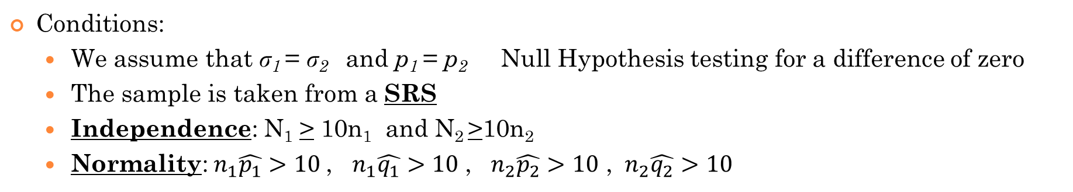
2 Sample Proportion -Test and Interval (Pooled) [Default]
Conditions:
  We assume that ₁ = ₂ and p₁ = p₂ Null Hypothesis testing for a difference of zero
  The sample is taken from a SRS
  Independence: N₁ > 10n₁ and N₂ >10n₂
  Normality:${ n}_{1}\hat{p_{1}}>10$ , ${ n}_{1}\hat{q_{1}}>10$ , ${ n}_{2}\hat{p_{2}}>10$ , ${ n}_{2}\hat{q_{2}}>10$
Test Statistics:
Confidence Interval:
Note: The null hypothesis is:
Textbook: The null hypothesis is testing that the difference in proportion is equal to ZERO!! In this case, the proportions will be pooled!

Slide 5
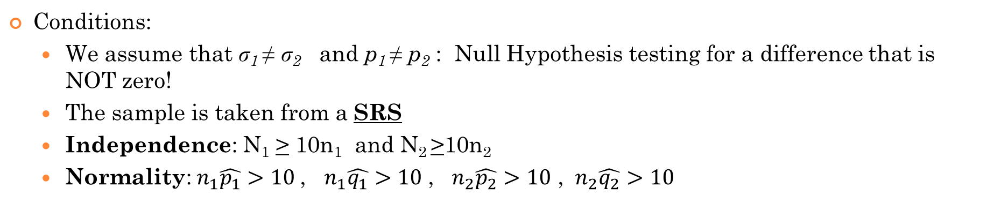
2 Sample Proportion -Test and Interval (Not Pooled)
Conditions:
  We assume that ₁ ≠ ₂ and p₁ ≠ p₂ : Null Hypothesis testing for a difference that is NOT zero!
  The sample is taken from a SRS
  Independence: N₁ > 10n₁ and N₂ >10n₂
  Normality:${ n}_{1}\hat{p_{1}}>10$ , ${ n}_{1}\hat{q_{1}}>10$ , ${ n}_{2}\hat{p_{2}}>10$ , ${ n}_{2}\hat{q_{2}}>10$
Test Statistics:
Confidence Interval:
Remember, when getting C.I. p₁ and p₂ are unknown so we will be using our sample proportions!
Note: The null hypothesis is:
NOTE: If we are testing for a specific difference in proportion (NOT zero) then we will be using Non pooled.

Slide 6
In this section, we will compare learn to compare two population proportions by:
  i) Finding the confidence interval for the difference of two population proportions
  Note: If the confidence interval for p₁ – p₂ contains zero, it is evidence for the null hypothesis p₁ – p₂ = 0
  ii) Perform a hypothesis test between two sample proportions to determine if there is a difference between two population proportions
Conditions for two sample proportion problems:
  The parameter of interest is binomial → not “means”
  There must be two separate/independent populations → not paired T
  Sample from each population must also be independent

Slide 7

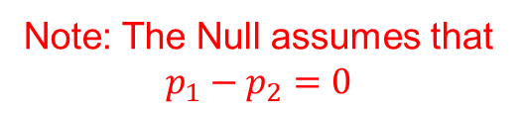
Formulas You need to Know:
Combined proportions is used when we are calculating the test statistics for hypothesis testing
Z - Value for Hypothesis Testing:
Note: The Null assumes that $p_{1}−p_{2}=0$
Confidence Interval:

Slide 8
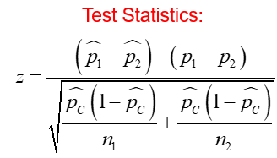
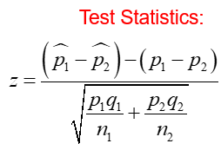

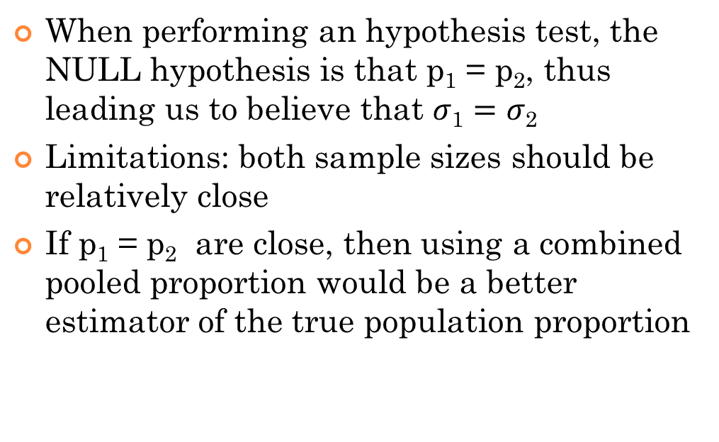
Pooled vs Un Pooled for Test Statistics:
Pooled
UnPooled
When performing an hypothesis test, the NULL hypothesis is that p₁ = p₂, thus leading us to believe that $σ\text{1}=σ\text{2}$
Limitations: both sample sizes should be relatively close
If p₁ = p₂ are close, then using a combined pooled proportion would be a better estimator of the true population proportion
If the two sample sizes are very different
If there is evidence for substantial difference between p₁ and p₂
In general, if the two population proportions are very different, it would not make sense to combine their samples

Slide 9
Notations:
Parameters
Statistics
The standard ERROR for finding the confidence interval (C.I.)
The standard Error finding our Test Statistics , Z-score (TEST)

Slide 10
Conditions For Performing a 2 Sample Proportion Test or Finding a Confidence Interval
Conditions that must be met before we can make any inference on p₁ – p₂
1. SRS: The data is a simple random sample and should be representative of the population of interest
2. Independence: The samples being compared should be independent of each other AND the population is ten times the sample size [sampling without replacement]
Normality – distribution of the sample proportion is normally distributed (CLT)
  Conditions must be true for finding a confidence interval
In some AP study guides, the minimum is 10, and not 5. This condition is to ensure that our sample size is large enough
On page 809, it states that
“we’ll be safe to perform significance tests on p₁ – p₂ as along as all these values are alteast 5”

Slide 11
When these conditions are all met, then we can use the difference in sample proportions: as an unbiased estimator for the difference in population proportions: p₁ – p₂
The variance of is the sum of the variance of and
Variance of p₁ – p₂
Standard
Deviation of
p₁ – p₂

Slide 12
Confidence Interval for Comparing Two Samples
Formula for obtaining a level C confidence interval of the difference in population proportion p₁ – p₂
z* is the upper standard normal critical value

Slide 13
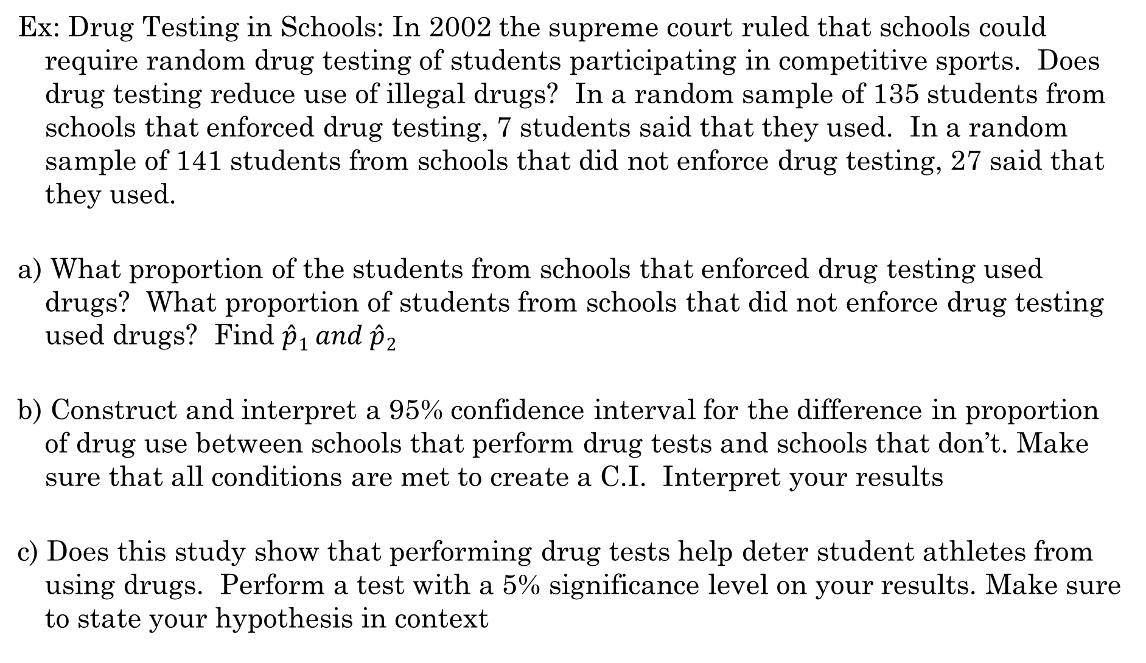
Ex: Drug Testing in Schools: In 2002 the supreme court ruled that schools could require random drug testing of students participating in competitive sports. Does drug testing reduce use of illegal drugs? In a random sample of 135 students from schools that enforced drug testing, 7 students said that they used. In a random sample of 141 students from schools that did not enforce drug testing, 27 said that they used.
a) What proportion of the students from schools that enforced drug testing used drugs? What proportion of students from schools that did not enforce drug testing used drugs? Find $\hat{p}1 and \hat{p}2$
b) Construct and interpret a 95% confidence interval for the difference in proportion of drug use between schools that perform drug tests and schools that don’t. Make sure that all conditions are met to create a C.I. Interpret your results
c) Does this study show that performing drug tests help deter student athletes from using drugs. Perform a test with a 5% significance level on your results. Make sure to state your hypothesis in context

Slide 14
a) Let “A” be the population of schools that enforced drug testing
Let “p_{A}” be the true proportion of students that use drugs from schools that enforced drug testing
Let “B” be the population of schools that did not enforce drug testing
Let “p_{B}” be the true proportion of students that use drugs from schools that did not enforce drug testing
Sample Proportions P_{A} & P_{B}
b) We want to create a confidence interval to estimate the true difference in population proportion between p_{A} and p_{B.} The parameter of interest will be: p_{A} – p_{B}

Slide 15
Identify the statistical procedures to use and verify the conditions for using them.
Will we use a two-sample proportion z-interval
Conditions:
Randomization: It is stated that both samples are SRS from their respective populations.
Independence: The two samples and the populations are from separate schools and should independent from one another. The population size should be more than 10 times the sample size.
Normality: Show the calculations that the conditions are met:
Under these conditions, the sampling distribution for the difference in population proportions will be approximately Normal.

Slide 16
Find the Confidence Interval: (Note: use a Ti83). This would be a “2-SampZint.”
Our 95% confidence interval states that the difference in proportion of student athletes using drugs is 6% to 21% less in schools that enforce random drug testing than schools that don’t.

Slide 17
c) Perform a test on whether if enforced random drug testing help deter student athletes from drug use. State the hypothesis:
The difference in proportion of student athletes using drugs between schools that perform random drug testing and schools that don’t is zero
The difference in proportion of student athletes using drugs between schools that perform random drug testing and schools that don’t is greater than zero
The proportion of student athletes using drugs in schools that perform random drug testing is the same in schools that don’t perform random drug testing
The proportion of student athletes using drugs in schools that perform random drug testing is less than schools that don’t perform random drug testing
Conditions: SRS, Independence, and Normality were all met.

Slide 18
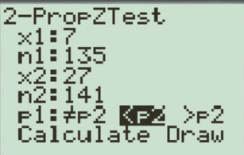
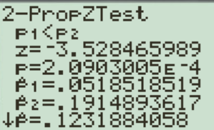
Calculate our test statistics….
It’s ok to use our Ti83 to calculate the test statistics, however, make sure that you write out your work and calculations!
Since our P value is less than the significance level of 5% or any other reasonable significance level, we would reject our Null Hypothesis and accept the Alternative. Our test shows that the proportion of student athletes in schools that does random drug testing is less than schools that doesn’t do random drug testing

Slide 19
Ex: A political candidate recently got involved in a media scandal. Two months ago a survey was conducted on the approval ratings of the candidate. In a SRS of 300 candidates, 170 said they would vote for him. Three months after the scandal another survey conducted with a SRS of 450 candidates, 213 said they would still support him. Has the approval of the candidate decreased after the scandal? Conduct an appropriate test and then find the test statistics and P-value

Slide 20
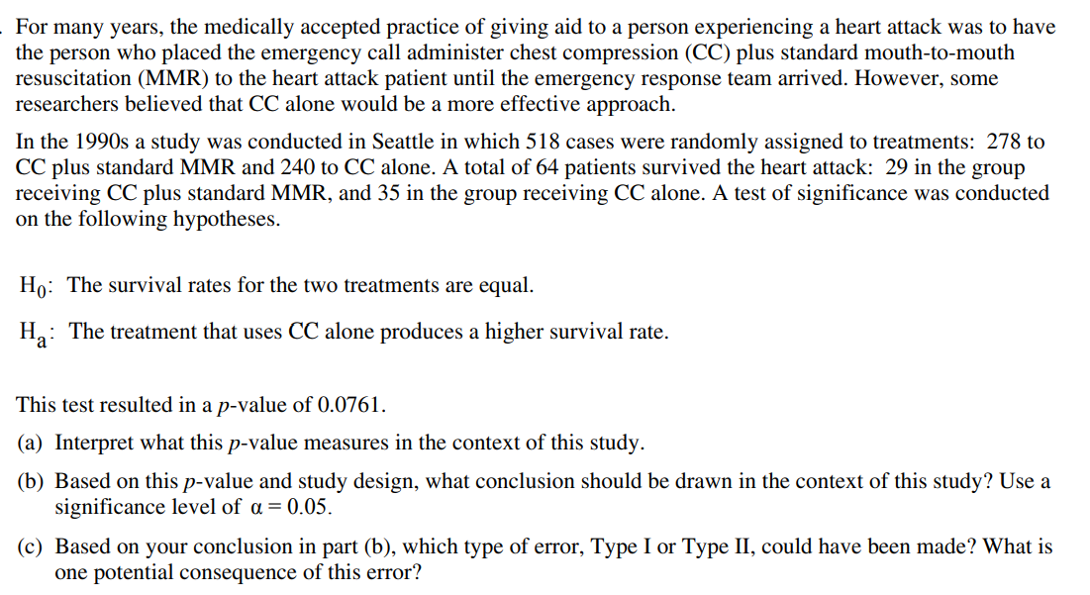

Slide 22
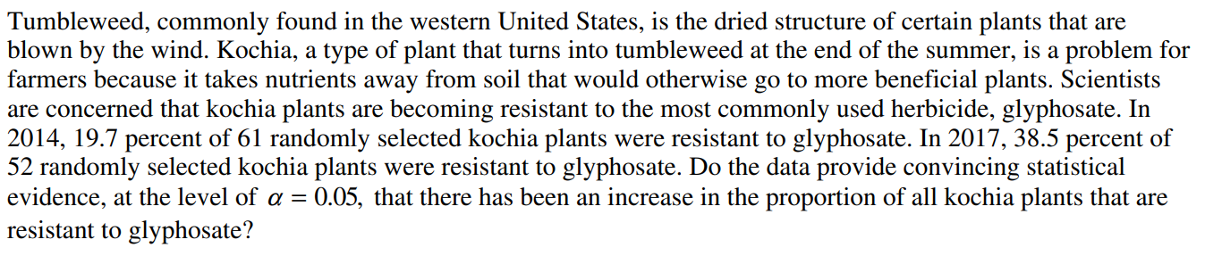
a) State the Null and Alternative Hypothesis in context
b) Find the Zscore from the statistics and calculate the P-value
c) Use your Ti 83 to find the P-value. IS there a discrepancy between your P values
d) State your conclusion in the context of this problem
e) Find a 99% confidence interval for the percentage difference in kochia plant resistance to glyphosate herbicide between 2014 and 2017

Slide 23
State the Null and Alternative Hypothesis:
Let pa be the proportion of kochia plants in 2014 that are resistant to glyphosate
Let pb be the proportion of kochia plants in 2017 that are resistant to glyphosate
The difference in proportion of kochia plants that are resistant to glyphosate is zero
The difference in proportion of kochia plants that are resistant to glyphosate is greater than zero
The proportion of kochia plants that are resistant to glyphosate in 2014 and 2017 are equal
The proportion of kochia plants that are resistant to glyphosate in 2017 is greater than the proportion of kochia plants in 2014

Slide 26
Ex: Prayer and in vitro fertilization p807.
Two groups of women, randomly assigned, are about to undergo in vitro fertilization. Women in the treatment group were intentionally prayed by several people who did know them. (Intercessory prayer). The women in the controlled group were not prayed for. The praying lasted for three weeks following in vitro fertilization.
Results: 44 out of 88 women in the treatment group got pregnant compared to 21 out of 81 in control group.
a) Are the results of the study statistically significant? State the hypothesis and conditions. Interpret your results.
b) Does this study show that intercessory prayer causes an increase in pregnancy for women undergoing in vitro fertilization? Why or why not?

Slide 27
1. State the hypothesis
P1: The proportion of pregnancy in the treatment group
P2: The proportion of pregnancy in the controlled group
2. Verify the conditions:
Since we are testing a claim about two population proportions, we should
use a two-proportion z test if the conditions are met:
i) SRS: Since the subjects were not randomly selected from a larger population, this may limit the researchers’ ability to generalize the findings of this study
ii) Normality:

Slide 28
Independence: Due to random assignment, these two groups of women can be viewed as independent samples. As well, the population of women undergoing in vitro fertilization is atleast 10 times greater than the sample
3: Calculations: Test statistics
Since 0.000678 < 0.01, we reject Ho. This is very strong evidence that the observed
difference in the proportion of women who became pregnant is not due to chance
b) This study shows that intercessory prayer may cause an increase in pregnancy.
However it is unclear if the women knew that they were in a treatment group.
If they found out that other people were praying for them, then their behaviours
may have changed

Slide 29
Two 95% confidence intervals estimates are obtained:
Sample 1: (68,73) Sample 2: (70, 78)
Q1: If the sample sizes are the same, which sample has the larger standard deviation?
Q2: If the standard deviations are the same, which sample has a larger size?
If the sample are the same, and sample 2 has a larger spread, that means it has a larger standard deviation
In general, a larger sample will generate a smaller Standard error, thus resulting in a narrower interval. Therefore, sample 1 would have a larger sample IF the SD were the same.

Slide 30
The AP score between male and female students were as follow: for 500 male students, the mean was 2.95 with SD of 1.65. For 450 female students, the mean was 3.05 with a SD of 1.80. Assuming all conditions for inference were met, establish a 90% Conf. Interv. for the difference in population mean:

Slide 31
Statistics Test for p₁ – p₂
First find pooled/combined proportion:
X₁ and X₂ are the counts of successes in each sample
The test statistics for comparing two population proportions will be:
Conditions for Normality:
P815: The two proportion z test is still accurate as long as all
these values are atleast 5

Slide 32
The recommendation that the population size should be at least 10 times the sample size is often mentioned in introductory statistics textbooks and courses as a general guideline for sample size determination. This guideline is based on the assumption of simple random sampling with replacement, which is a common sampling method used in many statistical analyses.
The reason for this guideline is that when the sample is drawn randomly with replacement, each observation has an equal probability of being selected. As a result, the observations in the sample are considered independent and identically distributed, and the sampling distribution of the sample proportion is approximately normal, even if the population proportion is not.
In the case of proportions, the standard error of the sample proportion is proportional to the square root of the population proportion times one minus the population proportion, divided by the sample size. When the population size is much larger than the sample size, the population proportion can be estimated with sufficient accuracy and precision, and the sampling distribution of the sample proportion is nearly normal, regardless of the actual population proportion.
However, it's important to note that this guideline is only a rough approximation, and there are many factors that can affect the validity and accuracy of statistical analyses, including the sampling method, the research question, the effect size, the level of significance, and the statistical power. In practice, sample size determination should be based on a thorough understanding of the underlying assumptions and requirements of the statistical method being used, and should take into account the specific context and constraints of the research study

